Slide 1
SNMP & WWW -by Hitesh Nautiyal

Slide 2
SNMP(Simple Network Management Protocol):-
It is basically a framework that is used for managing the devices on the internet by using the TCP/IP protocol suite.
Basically, SNMP provides a set of fundamental operations in order to monitor and maintain the Internet.
It is an application layer protocol that was defined by the Internet engineering task force.
This protocol is mainly used to monitor the network, detect the faults in the Network, and sometimes it is also used to configure the remote devices.

Slide 3
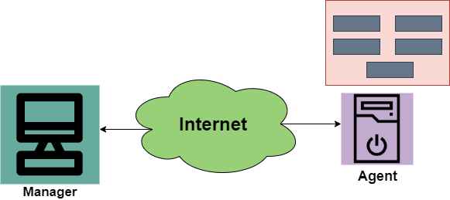
Diagram of SNMP :-

Slide 4
The SNMP protocol makes the use of Manager and Agent; where the manager is usually a host that controls and monitors the set of agents.
The SNMP is an application-level protocol and it consists of a few manager stations that mainly controls a set of agents. This protocol is mainly designed at the application level so that it can monitor the devices that are mainly made by different manufacturers and that are installed on different physical networks.
Thus there are three components in the architecture of the SNMP:
SNMP Manager
SNMP Agent
Management Information Base

Slide 5
SNMP Manager
It is basically a centralized system and it is mainly used to monitor and manage devices that are connected with the network. SNMP manager is typically a computer and it is used to run one or more network management systems.
Given below are the main functions of SNMP Manager:
Collects response from the agents.
To acknowledge asynchronous events from the agents.
To set variables in the agent.
Queries the Agent
SNMP Agent
SNMP Agent is basically a software program that is packaged within the network element. It is mainly installed on a managed device where managed devices can be switches, servers, routers, PC, etc.
Mainly the agents keep the information in the database also the manager has the access to the values present in the database.
Given below are the main responsibilities of the SNMP Agent:
SNMP agents mainly collect the management information about its local environment
The SNMP agent mainly signals an event to the manager.
The SNMP agents also act as a proxy for some non–SNMP manageable network nodes.
Thus the management with SNMP is mainly based on these given ideas:
1. An SNMP manager checks the agent by requesting information that mainly reflects the behavior of the SNMP agent.
2. The SNMP manager also forces the agent to perform the task by resetting the values in the database of the agent.
3. Management process is also contributed by the agent just by warning the SNMP manager about an unusual situation.

Slide 6
Management Components
In order to perform the Management tasks, the SNMP protocol makes the use of two other protocols and are SMI and MIB. We can also say that the Management on the Internet is done by the cooperation of three protocols and these are SNMP, MIB, SMI.
Role of SNMP
The SNMP protocol performs some specific roles in Network Management;
It mainly defines the format of the packet that needs to be sent from the manager to the agent or vice-versa.
SNMP is also used to interpret the result and create the statistics.
The packets that are exchanged between the manager and agent contains the name of the object(variable) and their status(values).
The SNMP is also responsible for reading and changing these values.
Role of SMI
In order to use the SNMP, there is a need for some rules and these rules are for naming the objects. Now its time to take a look at the roles of SMI:
SMI(Structure of Management Information) is mainly used to define the general rules for naming the objects.
It is also used to define the type of objects that includes( range and length).
This is also used to show how to encode the objects and values.
The SMI does not define the number of objects that should be managed by an entity.
It also does not define the association between the objects and their values.
Role of MIB
In order to manage each entity, this protocol is mainly used to define the number of objects and then to name them according to the rules defined by the SMI and after that associate a type to each named object.
MIB( Management Information Base) is mainly used to create a set of objects that are defined for each entity that is similar to the database.
Thus MIB mainly creates a collection of named objects, their types.

Slide 7
World Wide Web
The World Wide Web or Web is basically a collection of information that is linked together from points all over the world. It is also abbreviated as WWW.
World wide web provides flexibility, portability, and user-friendly features.
It mainly consists of a worldwide collection of electronic documents (i.e, Web Pages).
It is basically a way of exchanging information between computers on the Internet.
The WWW is mainly the network of pages consists of images, text, and sounds on the Internet which can be simply viewed on the browser by using the browser software.
It was invented by Tim Berners-Lee.
Components of WWW
The Components of WWW mainly falls into two categories:
Structural Components
Semantic Components

Slide 8
Architecture of WWW :-
The WWW is mainly a distributed client/server service where a client using the browser can access the service using a server. The Service that is provided is distributed over many different locations commonly known as sites/websites.
Each website holds one or more documents that are generally referred to as web pages.
Where each web page contains a link to other pages on the same site or at other sites.
These pages can be retrieved and viewed by using browsers.
In the above case, the client sends some information that belongs to site A. It generally sends a request through its browser (It is a program that is used to fetch the documents on the web).
and also the request generally contains other information like the address of the site, web page(URL).
The server at site A finds the document then sends it to the client. after that when the user or say the client finds the reference to another document that includes the web page at site B.
The reference generally contains the URL of site B. And the client is interested to take a look at this document too. Then after the client sends the request to the new site and then the new page is retrieved.

Slide 9
1.Client/Browser
The Client/Web browser is basically a program that is used to communicate with the webserver on the Internet.
Each browser mainly comprises of three components and these are:
Controller
Interpreter
Client Protocols
The Controller mainly receives the input from the input device, after that it uses the client programs in order to access the documents.
After accessing the document, the controller makes use of an interpreter in order to display the document on the screen.
An interpreter can be Java, HTML, JavaScript mainly depending upon the type of the document.
The Client protocol can be FTP, HTTP, TELNET.
2.Server
The Computer that is mainly available for the network resources and in order to provide services to the other computer upon request is generally known as the server.
The Web pages are mainly stored on the server.
Whenever the request of the client arrives then the corresponding document is sent to the client.
The connection between the client and the server is TCP.
It can become more efficient through multithreading or multiprocessing. Because in this case, the server can answer more than one request at a time.

Slide 10
3.URL
URL is an abbreviation of the Uniform resource locator.
It is basically a standard used for specifying any kind of information on the Internet.
In order to access any page the client generally needs an address.
To facilitate the access of the documents throughout the world HTTP generally makes use of Locators.
URL mainly defines the four things:
Protocol It is a client/server program that is mainly used to retrieve the document. A commonly used protocol is HTTP.
Host Computer It is the computer on which the information is located. It is not mandatory because it is the name given to any computer that hosts the web page.
Port The URL can optionally contain the port number of the server. If the port number is included then it is generally inserted in between the host and path and is generally separated from the host by the colon.
Path It indicates the pathname of the file where the information is located.

Slide 11
4.HTML
HTML is an abbreviation of Hypertext Markup Language.
It is generally used for creating web pages.
It is mainly used to define the contents, structure, and organization of the web page.
5.XML
XML is an abbreviation of Extensible Markup Language. It mainly helps in order to define the common syntax in the semantic web.
Features of WWW
Given below are some of the features provided by the World Wide Web:
Provides a system for Hypertext information
Open standards and Open source
Distributed.
Mainly makes the use of Web Browser in order to provide a single interface for many services.
Dynamic
Interactive
Cross-Platform

Slide 12
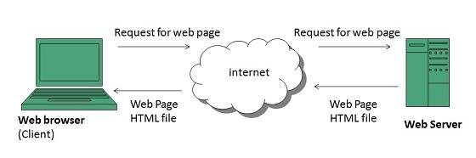
WWW Architecture :-

